Slide 1

How can the
Future Internet enable Smart Energy?
FINSENY overview presentation on achieved results
Prepared by the FINSENY PMT
April 2013

Slide 2
Outline
Motivation and basic requirements
FI-PPP approach
FINSENY vision and mission
Scenarios and high level architecture
Business modelling
Conclusions

Slide 3
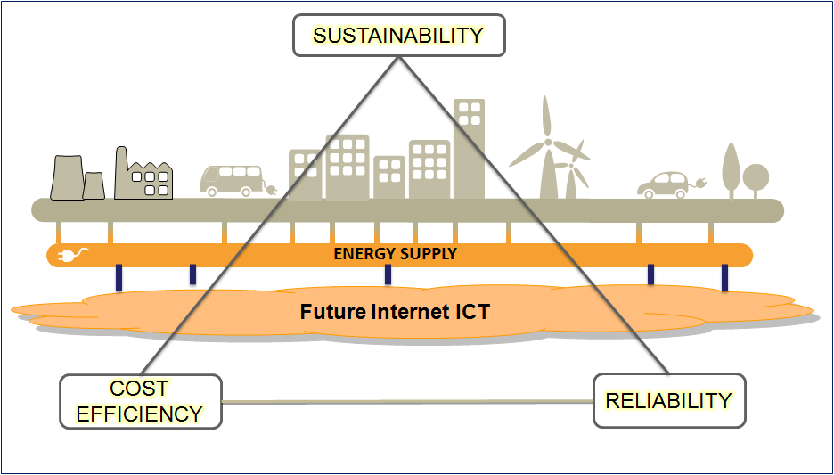
Motivation
In search of a sustainable energy system
    Europe has committed to 20/20/20 targets *
    Germany’s nuclear power phase out
Integrate renewable and decentralised energy generation
    need to cope with volatility
    need to optimally use existing grid infrastructures
Liberalisation of energy markets
    new services
    new market players
Combination of action fields
    smart grid and smart home
    smart grid and electric mobility
  ➔ ICT is the key enabler for the Smart Energy
* A 20% reduction in EU greenhouse gas emissions from 1990 levels;
Raising the share of EU energy consumption produced from renewable resources to 20%;
A 20% improvement in the EU's energy efficiency.
Source: EU Commission: http://ec.europa.eu/clima/policies/package/index_en.htm

Slide 4
Can the Internet be useful for Smart Energy?
The Internet provides
    A cost-efficient information and communication infrastructure with outstanding scalability and economy of scale
    Well-proven Internet technologies (e.g. TCP/IP protocol suite) for re-use in private networks
    Openness to new service providers and business models
Limitations of today’s Internet technology
    No guaranteed high priority
    Internet could introduce security gaps
    Internet technology does not fulfil the short and deterministic latency requirements (e.g. for tele-protections)
BUT the Internet is evolving fast, often at exponential rates, and adapting itself to users’ demands

Slide 5
Critical features for Smart Energy
Reliability
Minimal interruptions to supply at all customer levels
Safety
All members of society will be protected from dangerous occurrences
Security
Ensure compliance in the use of information and protect the network from unwanted intrusions whether physical or cyber systems
Adaptability
Be capable of operation with a wide mix of different energy sources and be self-healing through decision-making on a local level
Utilisation
Improved utilisation of assets through monitoring and control
Intelligence
The gathering and management of information relating to customers and assets throughout the network and using such information to deliver the features above

Slide 6
How is the Future Internet likely to evolve?
Evolution of communication networks
  New wireless (LTE) and wired technologies (Fiber-to-the-X)
  Increased bandwidth but also Classes of Services approaching real-time requirements
  Network virtualisation
Internet of Things
  New mechanisms to mange huge numbers of devices
  Sensor data can be collected, aggregated, processed and analysed to derive contextual awareness
  Improved control decisions
Internet of Services
  Facilitates complex business relationships between multiple stakeholders
  Innovative business applications
Cloud Computing
  Elasticity with private or public clouds
  transition of business models towards the “as a service “ paradigm

Slide 7
How can the Future Internet enable Smart Energy?
Connectivity
End-to-end connectivity between large varieties of grid elements, including distributed energy resources, building energy management systems and electric vehicles using public as well as private communication infrastructures.
Management
Smart Energy introduces a lot of new managed elements with increased data volume. Future Internet offers e.g. concepts for device registries, SW maintenance, Big Data analysis, network management, distributed processing.
Service Enablement
Future Internet enables new service platforms supporting e.g. multi-tenancy, dynamic pricing and billing services for instant collaboration between all relevant stakeholders including the prosumer.
Distributed intelligence
Future Internet Technologies will introduce new technologies into hardware and – even more so – in software, effectively injecting intelligence into the grid, e.g. to coordinate and control Distributed Energy Resources.
Security & Privacy
Future Internet Technologies will provide new and improved means to support security and privacy
Notes:
7

Slide 8
Basic idea of the FI-PPP
(Future Internet Public-Private-Partnership)
Content Management
Transport &
Mobility
Agribusiness
& Environment
Smart Energy
Public Safety
Usage Areas like …
Logistics
…
… require today
or in future …
Cloud Hosting
Applications / Services Ecosystem & Delivery
…
Data / Context Management
Security
…
Internet of Things
Interface 2 Networks & Devices
…
… which should be provided in a generic way by the Future Internet

Slide 9
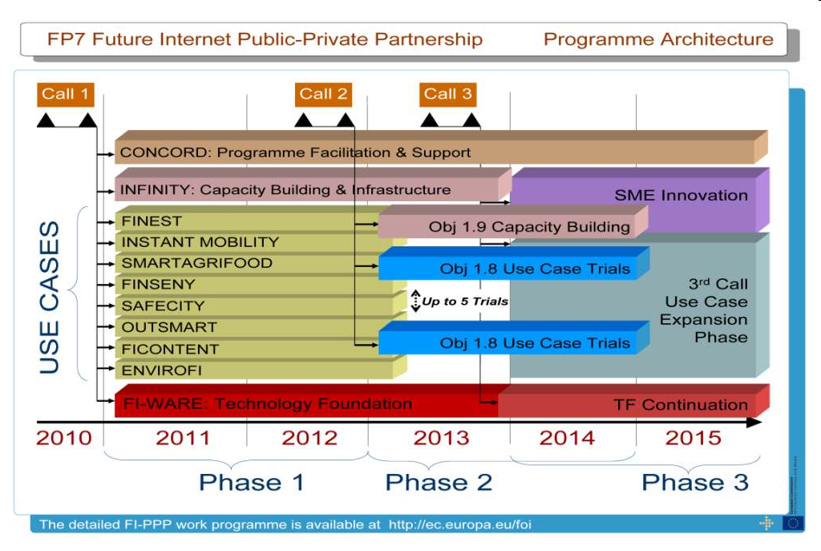
FI-PPP Programme
Identification of the requirements for each usage area
Generalization of requirements
Implementation
of generic requirements
as core platform
Deploy domain-specific
applications on core platform
Large-scale
testing

Slide 10
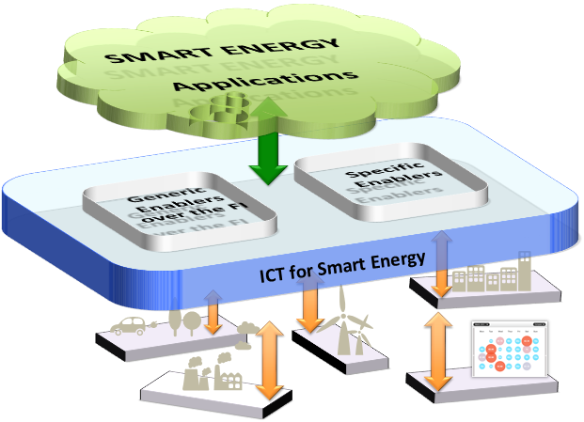
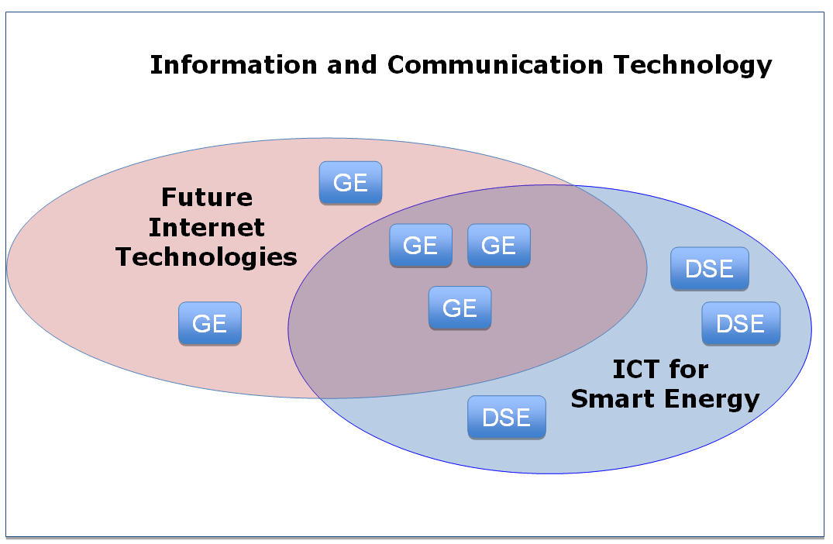
Future Internet Technology &
ICT for Smart Energy
ICT for Smart Energy will rely on generic enablers (GE) and domain-specific enablers (DSE)
GEs will be realised by the Future Internet core platform
  DSEs will add specific capabilities to the FI core platform which have, e.g., to meet the requirements for critical infrastructures
  Smart Grid Applications will be realised on top of the ICT for Smart Energy layer

Slide 11
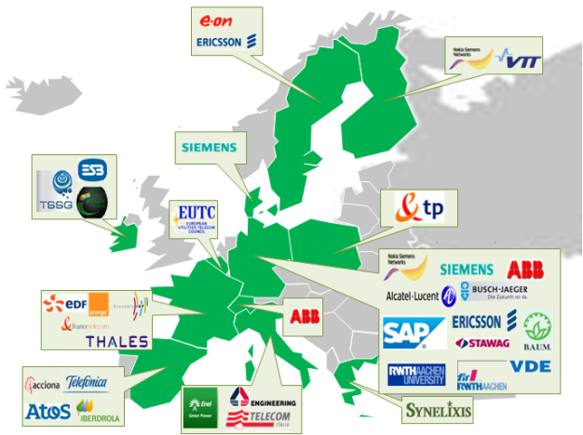
FINSENY project in brief
Vision
« A sustainable Smart Energy system in Europe, combining critical infrastructure reliability and security with adaptive intelligence, enabled by open Future Internet Technologies. »
Mission
« Demonstrate, by 2015, how open Future Internet Technologies can enable the European energy system to combine adaptive intelligence with reliability and cost-efficiency to meet, sustainably, the demands of an increasingly complex and dynamic energy landscape. »
Project details:
Duration: April 2011 – March (April) 2013
Partners: 35 partners from 12 countries from the energy and ICT domain
Part of the FI-PPP program
http://www.finseny.eu/
Notes:
11

Slide 12
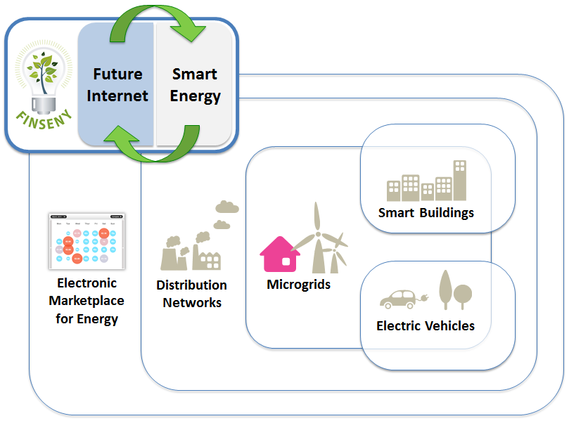
FINSENY Scenarios (I)

Slide 13
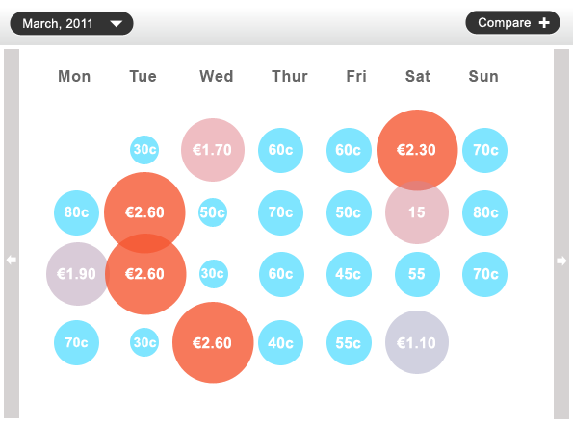
FINSENY Scenarios (II)
« Design a future ICT solution for Distribution System automation & control to increase energy quality, reliability, robustness and safety and to ease integration of Distributed Energy Resources. »
Distribution Networks
« Design a reliable and cost-efficient Microgrid platform which ensures flexibility, scalability and robustness. The design will be modular and applications/services will be loosely coupled. Devices in or at the edge of the grid (e.g. DERs) will be easily integrated and control/communication networks will be managed to ensure the right level of QoS. »
Microgrids
« Design of future comprehensive Building Energy Management Systems as flexible edge of the Smart Energy system and as key element for shared Future Internet platforms. »
Smart Buildings
«Design Smart Energy solutions so that Electric vehicles will be an integrated part of the energy infrastructure, maximising their benefits to the energy infrastructure. »
Electric Vehicle
« Design ICT systems to extend web based energy information, demand shaping and energy trading services for the emerging energy market players. »
Marketplace

Slide 14
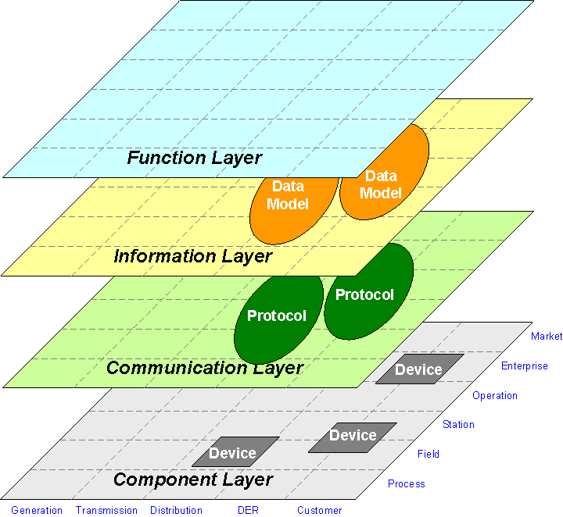
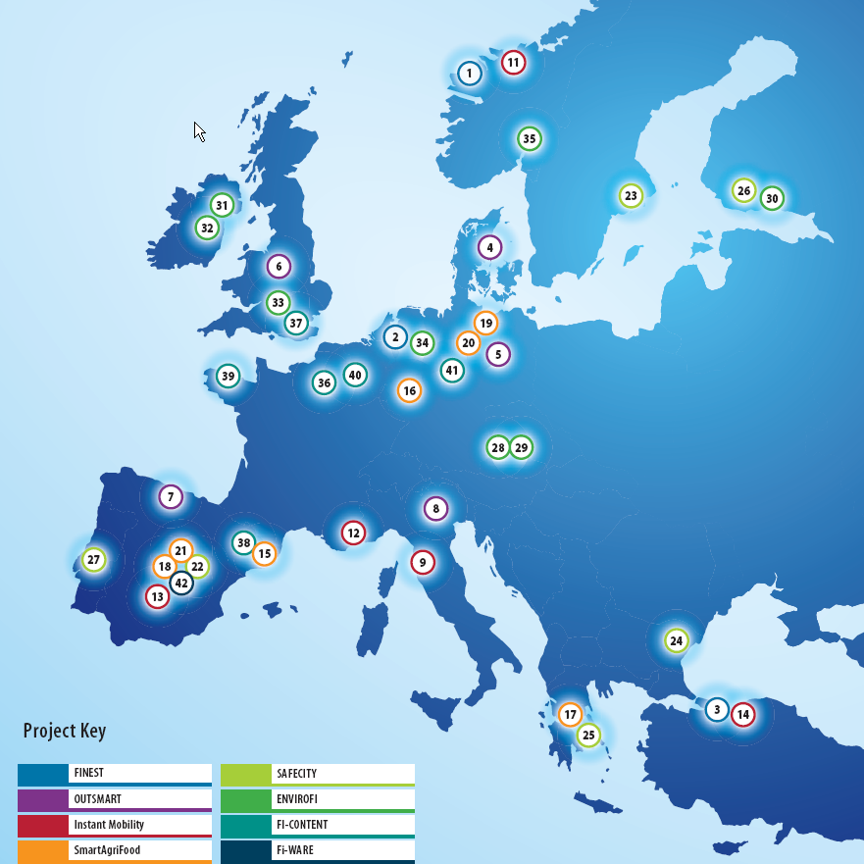
FINSENY‘s 4-Step Approach
Scenario description
    Identify use cases and actors (market roles as well as systems & devices) according IntelliGrid method
ICT requirements
    Define requirements for communication & information flows as well as services and middleware
Functional Architecture
    Identify key functional building blocks and interfaces, specify data models and communication protocols
    Develop ICT architecture based on common and domain specific enablers
Level
Domain
Trial candidates
    Identify trial candidates taking into account relevance, trial setup and reuse of existing trials

Slide 15
Smart Grid Architecture Model (SGAM) by CEN/CENELEC/ETSI Smart Grid Coordination Group RAWG
Represents use cases including logical functions or services independent from physical implementations
Represents information objects or data models required to fulfill functions and to be exchanged by communication
Represents protocols and mechanisms for the exchange of information between components
Represents physical components which host functions, information and communication means
Zone
Domain

Slide 16
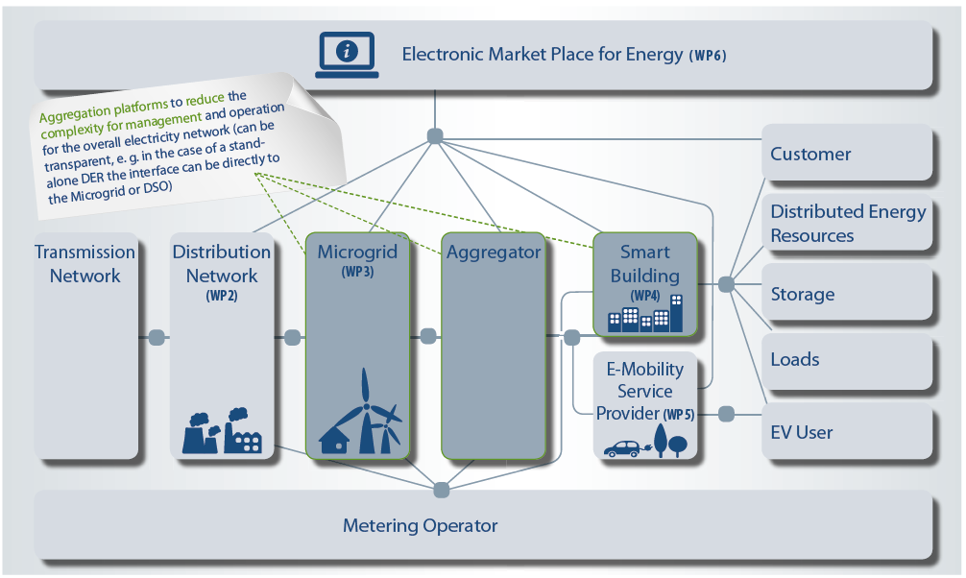
FINSENY High Level Architecture

Slide 17
Example: Auto-configuration
Generic and energy-specific requirements
Function Layer
Auto-configuration requirements
    Addressing
    Device description
    Registration & look-up
    Role-based Access Control
Generic Enabler
Energy-specific (e.g. ICD)
Generic Enabler
Generic Enabler
FI-WARE’s Internet of Things (IoT) Chapter will support functionalities like auto-configuration (Plug&Play) for managing huge numbers of devices & things in a generic way!

Slide 18
Finseny approach on Business Models & Market trends
  Methodology
    Use of Eurelectric business models methodology
  Stakeholders and business relationships
    Description of each scenario WP stakeholders and their business relationships
  Use cases business analysis
    FINSENY use cases have been mapped into the Functionalities (EC) / Benefits (EPRI) table defined by Eurelectric
  Business Opportunities
    From the tables mapping functionalities and benefits with the different scenario use cases, the methodology provides a way for deriving business opportunities, considering only most important stakeholders per WP, who are directly involved in the use cases
    Outline the impact of Future Internet for these business opportunities
Notes:
Business stakeholders relationships:
WP2: Elias Holger propose to discuss it with WP6 as it is very tricky en DS domain
WP3: Kolja provides a corrected version
WP4: Gilles proposes to include a “Building Operating System Manager” new actor
WP5: no answer
WP6: no answer

Slide 19
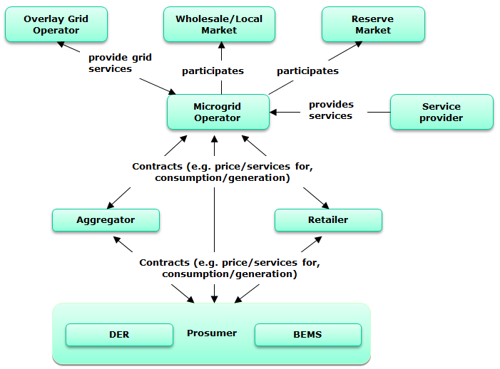
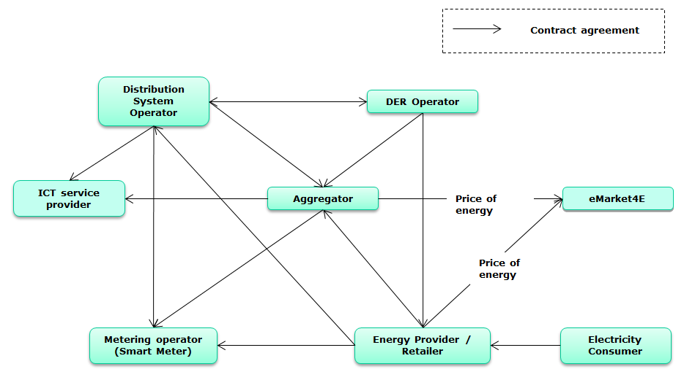
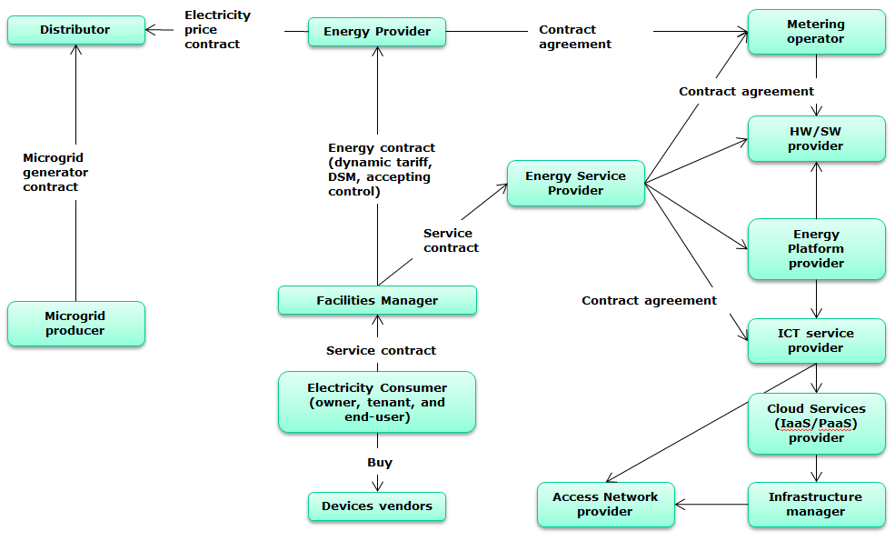
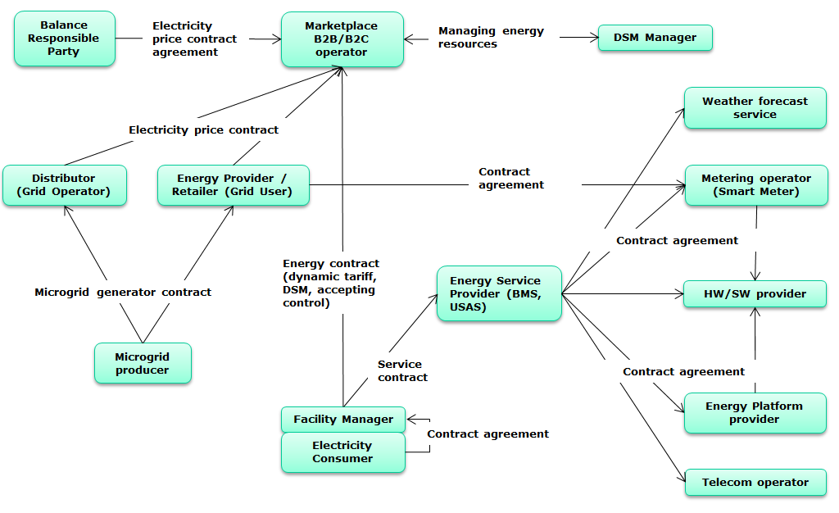
Stakeholders and Business Relationships
  One per Scenario WP
Notes:
Business stakeholders relationships:
WP2: Elias Holger propose to discuss it with WP6 as it is very tricky en DS domain
WP3: Kolja provides a corrected version
WP4: Gilles proposes to include a “Building Operating System Manager” new actor
WP5: no answer
WP6: no answer

Slide 20
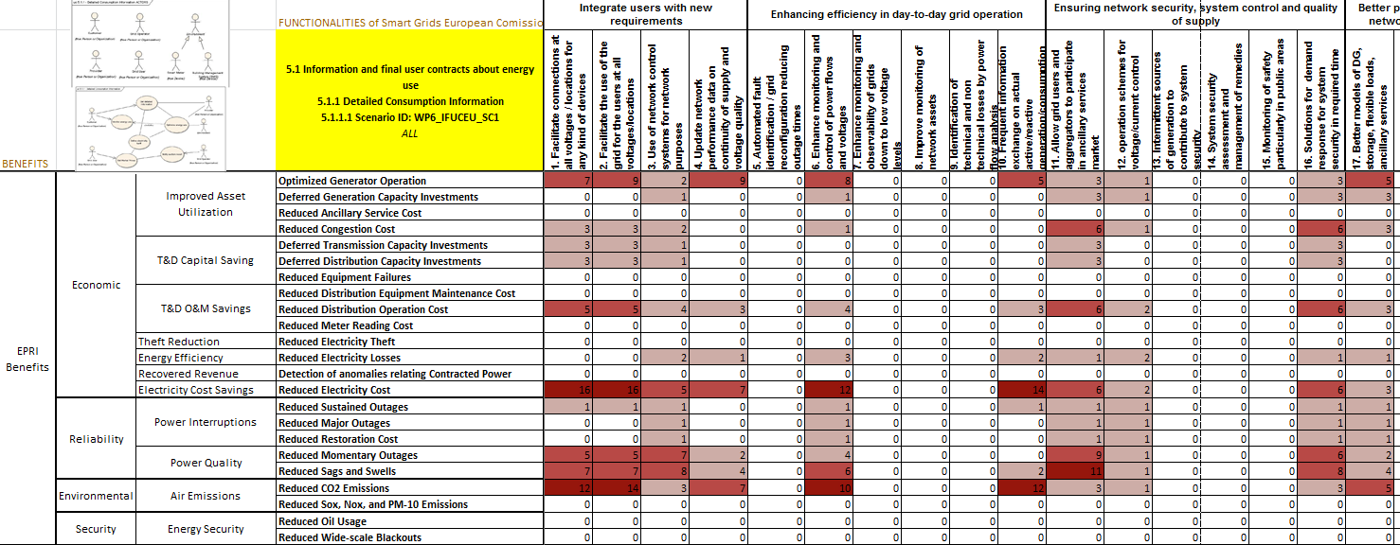
Use Case business analysis, identifying opportunity clusters

Slide 21
Identifying business opportunities
DER: Distributed Electrical Resources
BEMS: Building Energy Management System
Notes:
Business stakeholders relationships:
WP2: Elias Holger propose to discuss it with WP6 as it is very tricky en DS domain
WP3: Kolja provides a corrected version
WP4: Gilles proposes to include a “Building Operating System Manager” new actor
WP5: no answer
WP6: no answer

Slide 22
Conclusion
The FINSENY project
    Collected and selected use cases for its five scenarios
    Provided use case descriptions as input to SG-CG WG Sustainable Processes
    Identified ICT requirements within scenarios
    Consolidated ICT requirements in the project
    Coordination with the other FI-PPP usage areas
      requirements covered by generic enablers (FI-WARE)
      requirements covered by specific enablers (FINSENY)
    Develop consistent functional ICT architecture considering FI-WARE GEs for FINSENY scenarios
    Plan for consolidated Smart Energy trial
    Activities to describe potential business models

Slide 23
Interested to know more about FINSENY and Smart Energy?
  FINSENY Final Event in cooperation with EIT ICT Labs
    on April 10 and 11, 2013
    in Berlin
    http://www.fi-ppp-finseny.eu/finseny-smart-energy-enabled-by-future-internet-workshop/
Join the Smart Grid Stakeholder Group http://www.fi-ppp-finseny.eu/sgsg/
  Smart Grid Stakeholder Group (SGSG) has been established to better understand the views of the communications and energy industry.
  SGSG includes companies and institutes, who are interested in the research and exploitation of the Smart Energy challenges and the associated business opportunities.
  SGSG is open for all industrial players in the Smart Grid arena.

Slide 24

http://www.finseny.eu/finseny-white-paper/
THANK YOU FOR YOUR ATTENTION!

